Slide 1
ACA Spring Program
March 17, 2016

Slide 2
Core Music Standards = Music Literacy.
Students need to have experience in creating, to be successful musicians and to be successful 21st century citizens.
Students need to perform – as singers, as instrumentalists, and in their lives and careers.
Students need to respond to music, as well as to their culture, their community, and their colleagues.

Slide 3
For the earth will be filled with the knowledge of the glory of the Lord as the waters cover the sea. Habakkuk 2:14
Russia
Maine
Italy
Texas
Israel
Trinidad & Tobago
The Philippines
Ethiopia
Brazil
Papua New Guinea

Slide 4
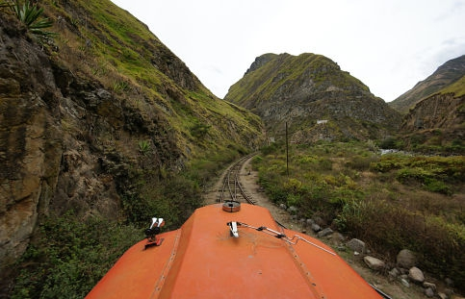
South America: Kindergarten
Sing (using head voice and appropriate posture) and move to music of various and contrasting styles, composers and cultures.
Play a variety of classroom instruments, alone and with others, maintaining a steady beat

Slide 5
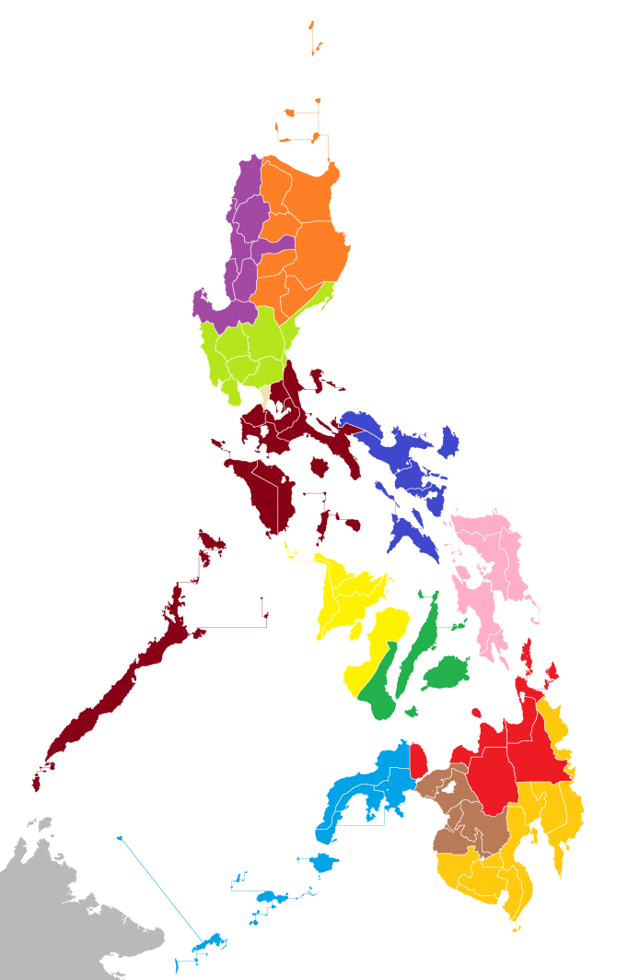
Philippines: 1st Grade
Explore steady beat, rhythm and meter
Listen to and identify music of
various and contrasting styles,
composers, periods and cultures

Slide 6
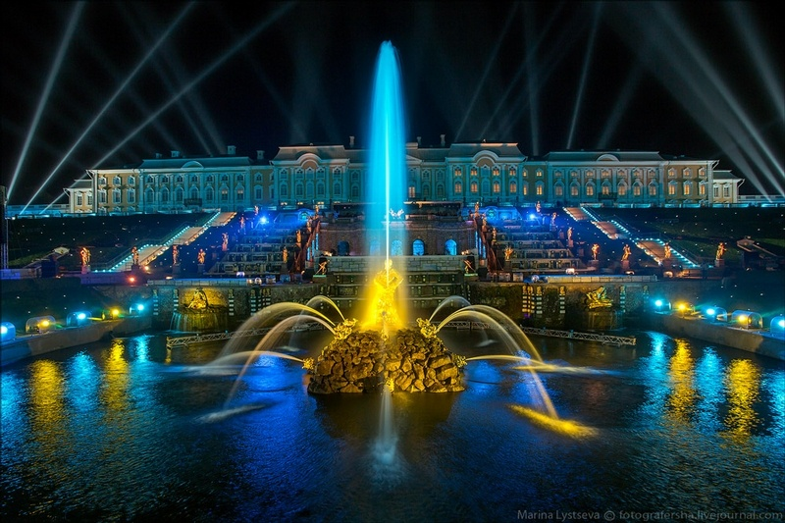
Russia and Trinidad & Tobago: Honors Choir
Use the head voice to produce a light, clear sound employing breath support and maintaining appropriate posture.
Sing, move and respond to music from world cultures and different composers.

Slide 7
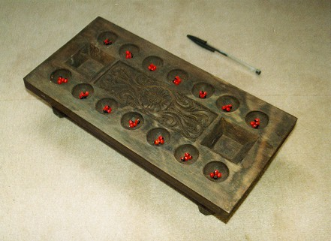
Africa: 2nd and 3rd Grades
Play a variety of classroom instruments with proper technique.
Follow and respond to the cues of a conductor

Slide 8
The Gebeta Board

Slide 9
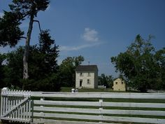
North America: 4th Grade
Improvise and compose short compositions using a variety of classroom instruments and sound sources.
Read, write and perform melodies on the treble staff.

Slide 11
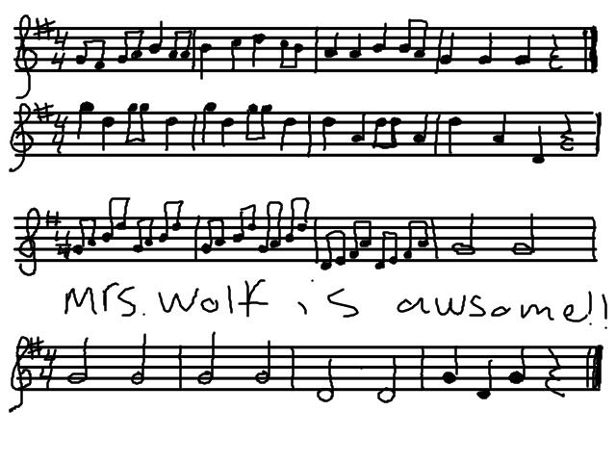

Slide 12
Papua New Guinea: 5th Grade
Sing a varied repertoire with accurate rhythm and pitch, appropriate expressive qualities, good posture and breath control.
Listen to and perform a wide variety of music from multiple cultures focusing on the historical and cultural significance of the works.

Slide 13
Me like behinim bigpela Jesus
No can go back, no can go back.
Suppose me one pela me yet behinim
No can go back, no can go back.

Slide 14
Junior High Choir
Collaboratively perform with good posture and breath control a varied repertoire of music representing diverse cultures with appropriate dynamics and tempo.
Apply problem-solving and critical thinking skills to music performing by adapting music to fit the context, story, and setting.

Slide 15
Western European Oratorio & American Spiritual: High School Choir
Demonstrate technical accuracy, appropriate tone quality, articulation, intonation and expression for the works being performed with good posture and breath control.
Prepare and accurately perform a varied repertoire of ensemble music showing continuous individual improvement in performance ability given the level of complexity found in the selected literature.

Slide 17
All the nations you have made shall come and worship before you, O Lord, and shall glorify your name.
For you are great and do wondrous things; you alone are God.
Teach me your way, O Lord, that I may walk in your truth; unite my heart to fear your name.
I give thanks to you, O Lord my God, with my whole heart, and I will glorify your name forever.
For great is your steadfast love toward me.
Psalm 86:9-13

